Slide 1
Investing on Ecosystem-based Commercial Agriculture in Nepal: A Pathway for Sustainable Growth
National Workshop on
Ecosystem-based Commercial Agriculture in Nepal
Kathmandu, Nepal
May 09, 2014
Bhishma P. Subedi, Ph.D. and Puspa Lal Ghimire
ANSAB (Asia Network for Sustainable Agriculture and Bioresources)
Notes:
Introduce the emerging need of transformation of traditional Agri. to enterprise-oriented sustainable Agri. in order to sustain effectively and contribute to sustainable development.
By presenting the progress and positive responses;
The untapped potential; and the challenges that we are facing today (spend a lot of time, little progress on this direction).
I will then present a glimpse of many lessons learned.
And conclude my presentation with ways forward by introducing a Framework for Action and
Some examples

Slide 2
Outline
What does Ecosystem-based Commercial Agriculture, or CSA in short, mean?
Where are we now?
What are the prospects?
Ways forward - how to turn comparative advantages into competitiveness and economic growth?
Notes:
What does Commercializing Sustainable Agriculture mean?
Where are we now? What is the present situation
What are the prospects? What are our competitive advantages and what is holding this back?
Ways forward - how to turn comparative advantages into competitiveness and economic growth?

Slide 3

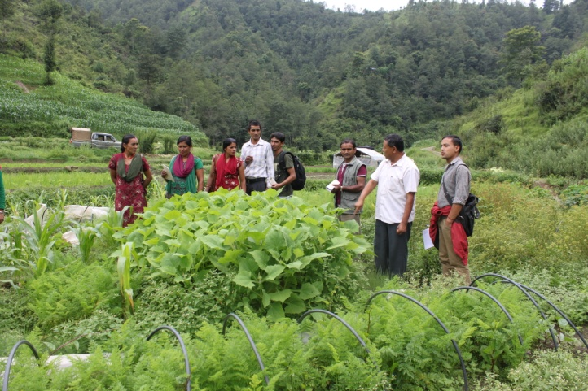
ANSAB
  Civil Society Organization, governed by an International Board, established in 1992
  Works in South Asia & headquartered in Kathmandu, Nepal
  Vision: Rich biodiversity & prosperous communities
  Mission: Generate & implement community-based, enterprise-oriented solutions
Photo: Farmers at Ashapuri Experimentation and Demonstration Centre centre
Notes:
To reach this ideal, our mission is to implement a variety of innovative community-based, enterprise-oriented solutions that we have developed over the year, such as the creation of micro-enterprises based on Non Timber Forest Products (or the elaboration of payment scheme the REDD+.

Slide 4
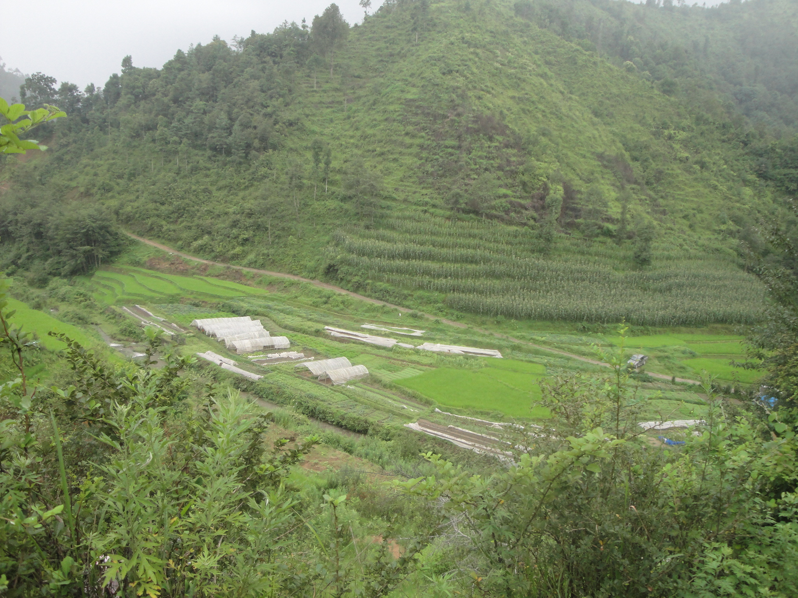
Ecosystem-based Commercial Agriculture
  What: Production and marketing of products and services in an ecologically sustainable, economically competitive, and socially justifiable manner (intensified, integrated and climate smart land use)
  Increases the production and productivity in a sustainable way – by conserving natural resources including biodiversity, maintaining
  soil health and fertility, reducing/
  removing emission of GHGs,
  and improving resilience of
  agro-ecosystems to adversities,
  esp. climate change;
Notes:
Assessment of integrated impacts: Gender, Food security, Energy security, Climate change mitigation and adaptation, Biodiversity, Soil fertility and nitrogen inputs
Offers resilience against adversities, especially climate change
Transform the traditional agriculture into ecologically sustainable, economically attractive and socially prestigious business
Increase in agricultural productivity and rural income level are necessary conditions for structural transformation of low-income countries, such as Nepal to attain economic growth

Slide 5
Ecosystem-based Commercial Agriculture
  Generates wealth through increased economic productivity – by balancing production with targeted end market(s) requirements (using remunerative farming components and crop varieties, improved seeds, soil nutrient management, farm mechanization and irrigation technologies), value addition, and proper marketing;
  Involves local communities, improves resilience of people to climate change, and generates integrated social impacts (on gender, social inclusion, food security, energy security, employment esp. for youths generating better remuneration and providing social prestige);
Notes:
Assessment of integrated impacts: Gender, Food security, Energy security, Climate change mitigation and adaptation, Biodiversity, Soil fertility and nitrogen inputs
Transform the traditional agriculture into ecologically sustainable, economically attractive and socially prestigious business
Increase in agricultural productivity and rural income level are necessary conditions for structural transformation of low-income countries, such as Nepal to attain economic growth

Slide 6
  Terms Closely Related to ECA
  Sustainable agriculture
  Organic agriculture
  Permaculture
  Ecological agriculture
  Conservation farming
  Climate-smart agriculture

Slide 7
Ecosystem-based Commercial Agriculture
  Why: to create a pathway for structural transformation, especially sustainable economic growth of Nepal balancing environmental sustainability, social justice and equity, and economic efficiency
Notes:
Transform the traditional agriculture into ecologically sustainable, economically attractive and socially prestigious business
Increase in agricultural productivity and rural income level are necessary conditions for structural transformation of low-income countries, such as Nepal to attain economic growth

Slide 8
Present Situation
Agriculture sector still dominates the economy providing about 1/3rd of the GDP and absorbing about 2/3rd of country’s labor force, of which 60% are food deficit
Dominated by subsistence farming, land fragmentation, and low level of knowledge, and suffers with low productivity and production
As a result, the poor are becoming poorer and we are suffering with a severe food deficit (two out of every three Nepalese are food unsecured)
Notes:
36% of the GDP and about 66% of population; Average agri. landholding is 0.68 ha/family; parcel size 0.21 ha;

Slide 9
Present Situation
Negative perception among the local people towards farming as menial, tedious and an un-prestigious employment
Led the rural people, especially youths, to migrate to urban areas and abroad in search of better livelihood opportunities and higher incomes - Every day about 1,500 youths leave for foreign jobs often leaving their children and elderly family behind
Notes:
Declining agricultrual labor force - Negative perception among the local people towards farming as menial, tedious and an un-prestigious employment partially due to small remuneration and the use of traditional farming practices

Slide 10
Present Situation
Recently, negative consequences of agriculture intensification with heavy loads of agro-chemicals are already evident
The results are human health hazards, environmental pollution, degradation of ecosystems, loss of biodiversity; loss of reputation in niche market
No clear, consistent agri. policy – often guided by donors and incompetent process
Notes:
Changing in diet, globalization and trade, outmigration, green technology and low carbon emission, diversification, modernization of distribution systems, increasing importance of quality and safety standards, rising cost of energy, impact of climate change, degradation of natural resource, and pressure for fiscal discipline

Slide 11
Comparative Advantage
Market: big & growing both at domestic & international level, esp. for nutritive, organic & eco-friendly products
Land and resource base: agro-ecological diversity offering opportunity to produce a range of unique and high-value niche products year-round
Labor force: traditional knowledge, skills
Highly integrated production system, esp. with community forestry – important for sustainable agriculture
Notes:
Increased awareness on organic and eco-friendly products
untainted products;
Export import of Agri commodities in 2010:
Nearly Rs. 60 arb or $600m ($598m) imported
Rs. 25 arb ($248m) exported; Rs 35 arb ($350m) in deficit

Slide 12
Comparative Advantage
Still a large portion of farmland available for sustainable, organic farming
Compatible to sustainable rural development with positive contribution in related sectors, e.g. forest, specialty tourism, esp. eco, nature and culture based tourism
High priority sector of the government – policy, plan, programs, budget and donor funded projects
Agriculture has started to be a subject of interest
Notes:
About 800,000 ha (26%) of agricultural land estimated to be organic by default in Nepal

Slide 13
Ways Forward
1) Define clear vision and pathways for agriculture development for Nepal
2) Develop agri-business development models
3) Define (adapt or adopt) and promote standards for sustainable agriculture and responsible business practices
4) Promote industrial competitiveness and growth of most promising value chains
5) Create enabling environment for agriculture

Slide 14
Define Vision
Policy
Technology
Natural Product Value Chain
BDS Market
Integration of local communities into value chain
Networked/ Balanced governance
Finance
•Investment
•Sustainable supply of raw material
•Increased incentive
Local Communities
Co-operatives
Sub-group
Organized & capable enterprise oriented community groups with access to natural resources
Increased income and employment
Farmers' group
•Goods
•Benefits
•Services
•Sustainable management
•Conservation •BD monitoring
Ecosystem
Improved management system
Biodiversity conservation and ecosystem services
© ANSAB
Notes:
Define the type of agriculture, farmers, purpose (meeting internal demand, means of economic development, synergy with other sectors, agriculture as a means sustainable development),
Need to be clear – can easily be organic without sacrificing investment, as there is no high investment in chemical based inputs. Think beyond farm land – other inputs, resources, markets

Slide 15
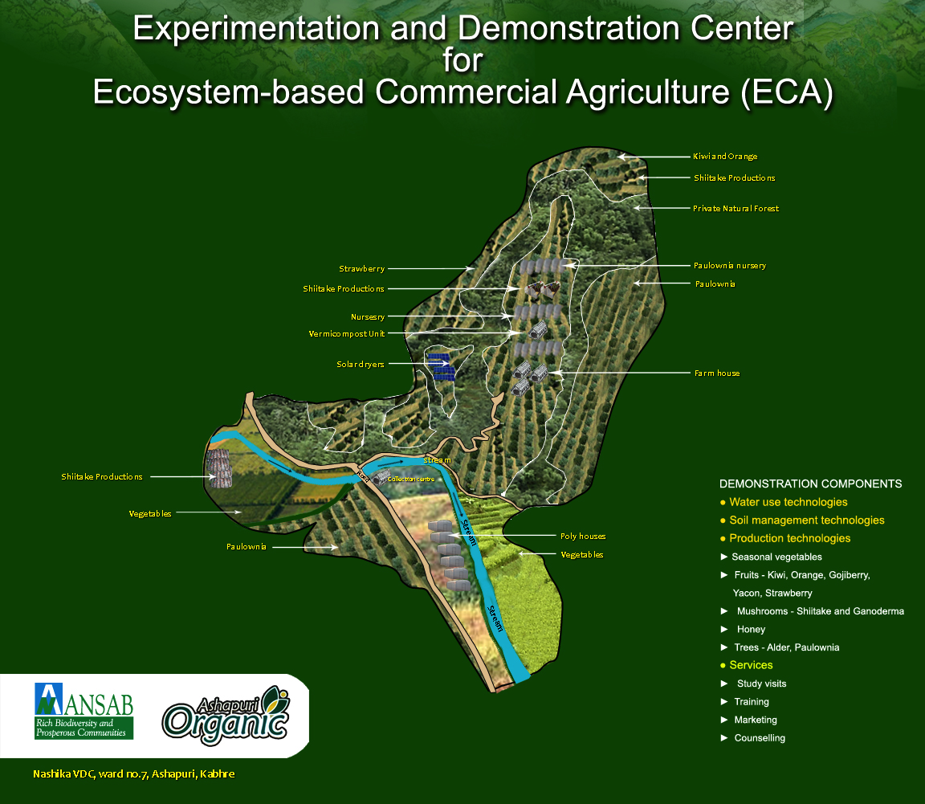
Notes:
Productivity increased, good market response, confidence built up,

Slide 16
Agri-business Models
Group and cooperative based farming and marketing
Partnership with lead firms for accessing finance, technologies and market

Slide 17
Investor with capital
seeks
Natural resources
and needs
Labourers
Traditional model
Local communities
manage
Natural resources
and seek
Capital and partnerships
New model

Slide 18
Standards for sustainable agriculture & responsible business practices
Develop national standards for good agriculture production, processing, manufacturing and distribution (by defining new or adapting or adopting from the international standards)
Continue to build sustainable agriculture practices and responsible business practices – expand to similar settings

Slide 19
Promote industrial competitiveness & growth
Identify most promising value chains coordinating at all levels – policy, industry, NGOs, donors, community; and develop a Nepal brand
Use science-based management to increase productivity and match with market information to prioritize products
Map and support clusters of producers
Support to organize farmers into groups, cooperatives, associations and federations at various levels

Slide 20
Promote industrial competitiveness & growth
Promote vertical linkages/cooperation to improve value-chain governance and trust
Remove market entry barriers both at domestic and international
Maintain data base and monitoring system to track supply and demand

Slide 21
Create enabling environment for agriculture
Form policy informed by science and with participation of farmers and industry
Develop land use plan clarifying tenure and access and addressing conflicts
Boost the morale of farmers - mass awareness on importance and value of agriculture business; recognize farmers as important citizen (certificate, priority on service, define it as a critical sector); mechanism to address risk of crop failure

Slide 22
Create enabling environment for agriculture
Provide basic infrastructure – irrigation, storage, transportation, markets, electricity, ICT
Support for farm mechanization and processing
Provision of inputs, esp. seeds and organic fertilizer
Provide easy and affordable access to loan

Slide 23
Create enabling environment for agriculture
Invest on practical research, education and extension services – planned phases of developing effective technology, testing efficiency and scaling up
Synergize with tourism, forest, culture, education and health

Slide 24
Thank You!
Visit www.ansab.org to
  Read our detailed capability statement
  Watch short documentaries about our work
  Consult more than 60 publications
  Subscribe to our newsletter, price list & more

